Slide 1
SAS Programming: Introduction
MAT: 3312
Fundamentals of Biostatistics

Slide 2
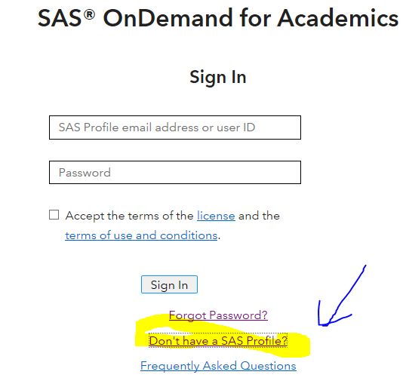
How to Sign up for SAS on demand
Go to webpage: https://welcome.oda.sas.com/login
Create a profile.

Slide 3
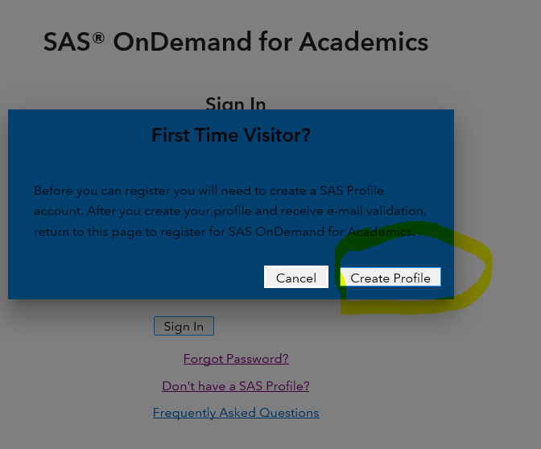
How to Sign up for SAS on demand
Before you can register you will need to create a SAS Profile account. After you create your profile and receive e-mail validation, return to this page to register for SAS OnDemand for Academics.

Slide 4
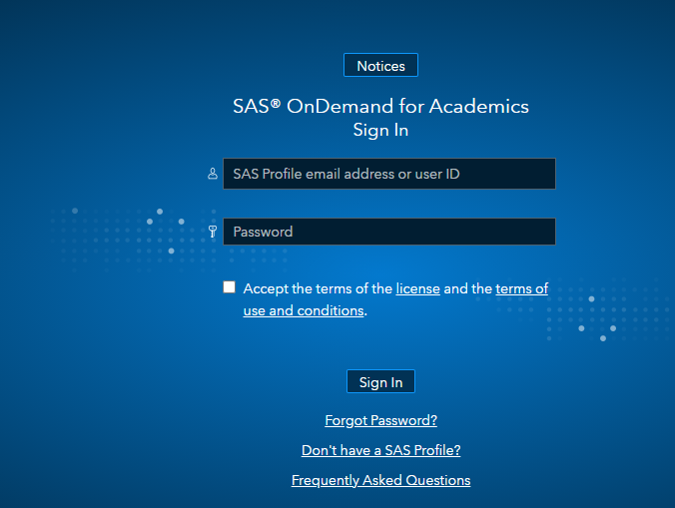
How to Sign up for SAS on demand
Return to this page to register for SAS OnDemand for Academics.
Try to sign in.

Slide 5
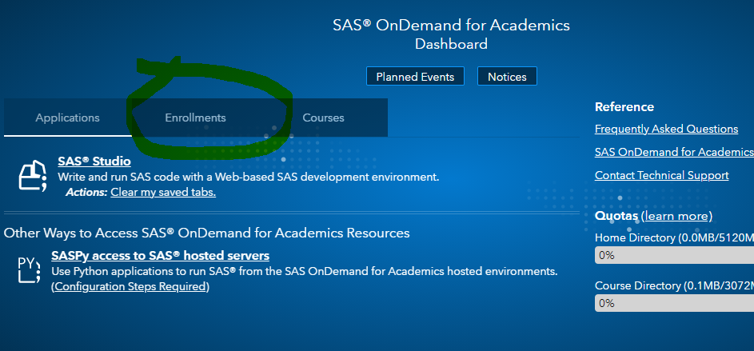
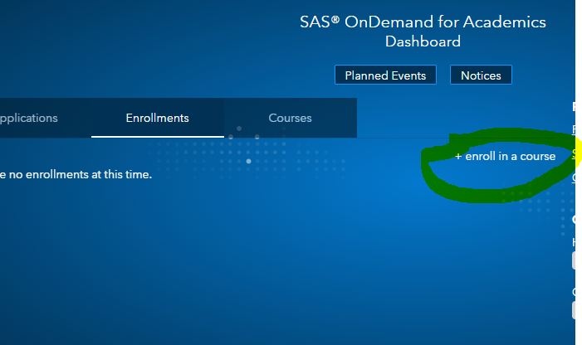
How to Sign up for SAS on demand
Look for the Enroll in a course link in the "Enrollments" section near the bottom of the page. Click this link to start the enrollment.

Slide 6
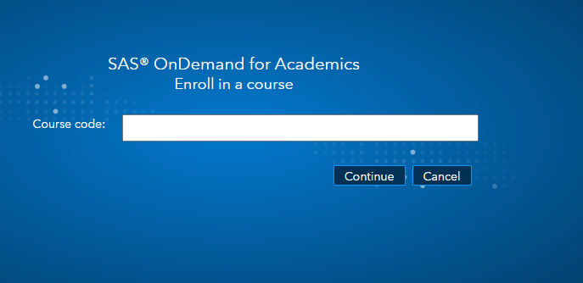
How to Sign up for SAS on demand
Enter the course code: aa4fb546-2fe7-4680-a173-9eb794ce3472
Submit the form.
Confirm that this is the correct course and then click the button to finish enrolling.

Slide 7
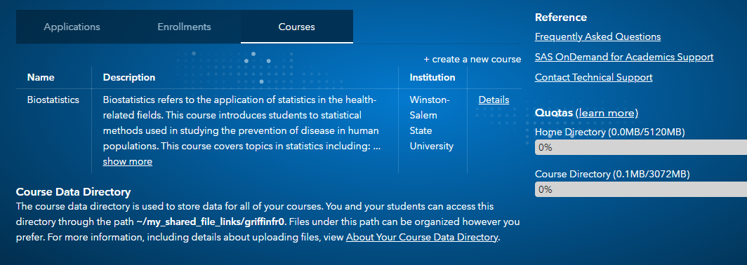
How to Sign up for SAS on demand

Slide 8
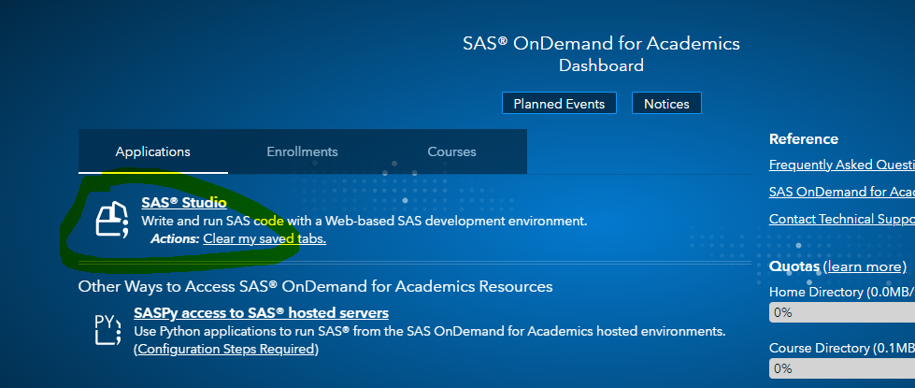
How to Sign up for SAS on demand
I plan to teach using the following software: SAS® Studio
Click on SAS Studio

Slide 9
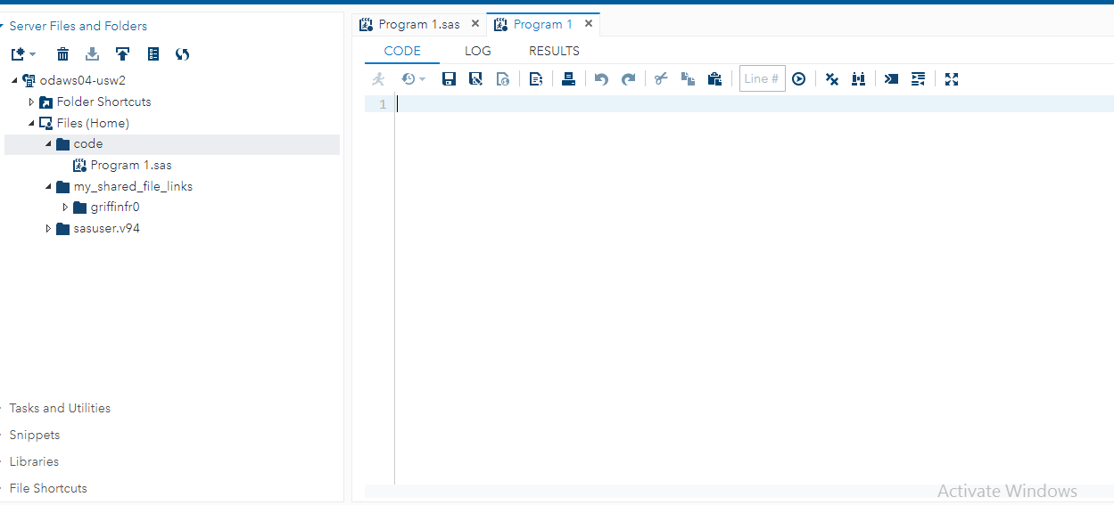
SAS Studio

Slide 10
Some (!) SAS windows
  Editor
    Where code is written or imported, and submitted
  Log
    What happened, including what went wrong
  Output
    Results of program procedures that produce output
Notes:
Open wp.sas for illustration

Slide 11
SAS Studio
Program Window: SAS Statements/Code Goes Here

Slide 12
SAS Studio
To open a new program

Slide 13
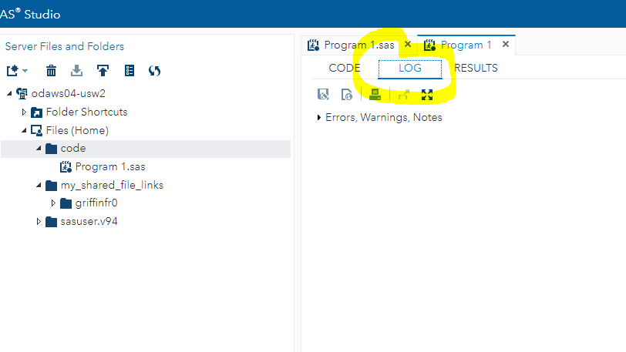
SAS Studio
SAS Log: Results of Program Execution/ Will tell you if you have any errors

Slide 14
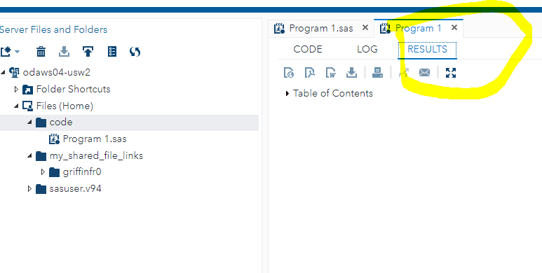
SAS Studio
SAS Log: Results/Output from code

Slide 15
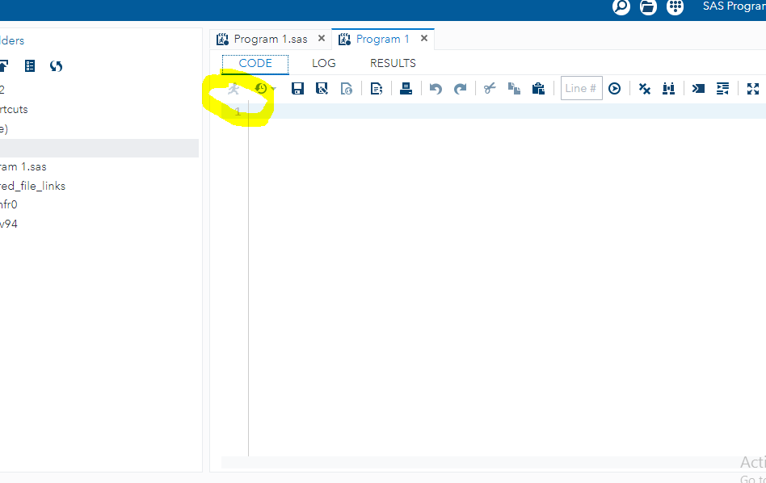
SAS Studio

Slide 16
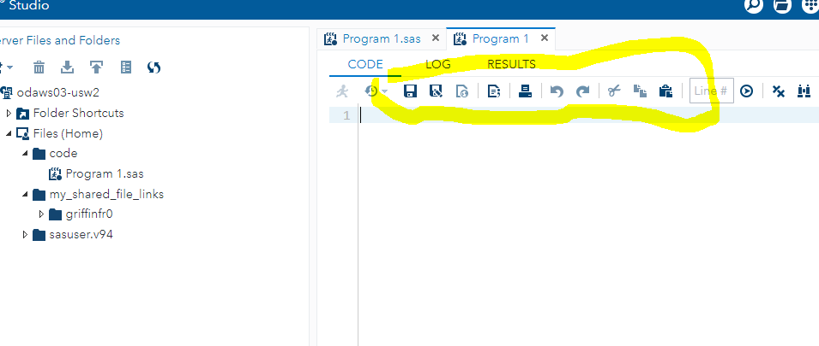
SAS Studio
Other Toolbar Functions

Slide 17
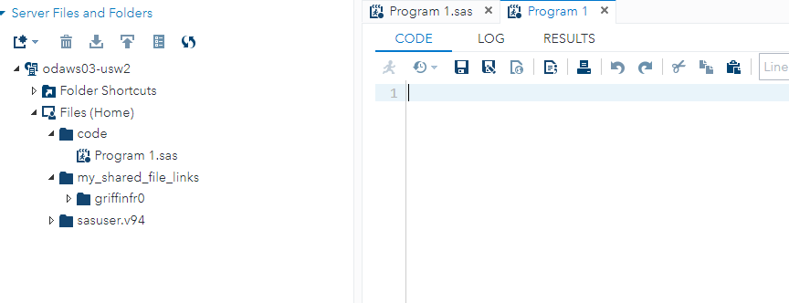
SAS Studio
Drop-Down Menus

Slide 18
Data Step
What is it?
What are the ingredients?
What can you do within it?
Some Basic Examples
What can you do with it?
Some More Examples

Slide 19
What is a Data Step?
A data step begins by setting up the data set. It is usually the first big step in a SAS program that tells SAS about the data.
A data statement names the data set. It can have any name you like as long as it starts with a letter and has no more than eight characters of numbers, letters or underscores.
A data step has countless options and variations.

Slide 20
Ingredients of a Data Step
Input statement
INPUT is the keyword that defines the names of the variables. You can use any name for the variables as long as it is 8 characters.

Slide 21
SAS Programs
All SAS Statements end with a Semi-colon
EXCEPT Data lines
Example SAS Statement:
  input name $ sex $ age height;
Comment lines are preceded by *

Slide 22
SAS Variable Names
1-8 characters
Must begin with a letter
Variables can be either numeric (meaning quantitative variable ) or character (meaning categorical variable).
SAS will assume that variables are numeric unless specified. To assign a variable name to have a character value use the dollar sign $.

Slide 23
Composition of SAS Programs
Beginning: Create a SAS data set
Middle: Work with data using SAS procedures (PROCs)
End: RUN the program

Slide 24
SAS and Data: SAS Data Sets
SAS is flexible. Can read data from many sources
First step is to convert raw data to a SAS data set

Slide 25
How to comment in your code
Type /* to begin a comment.
Type your comment text.
Type */ to end the comment.
Alternative:
* comment ;

Slide 26
How to is to convert raw data to a SAS data set
Subjects | Gender | Age | Height | Weight
Mike | M | 14 | 69 | 112
Tasha | F | 13 | 56 | 84
Maggie | F | 14 | 62 | 102
Sean | M | 15 | 67 | 135
John | M | 16 | 70 | 165
Sophia | F | 16 | 63 | 120
We will convert the raw dataset above into a SAS file.

Slide 27
The Beginning: How to is to convert raw data to a SAS data set
/*How to is to convert raw data to a SAS data set*/
/* Step 1: Create a SAS data set*/
data htwt; /* create data set named HTWT*/
data: Tells SAS the name of the SAS data set being
created.

Slide 28
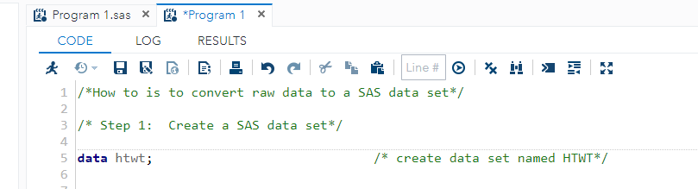
The Beginning: How to is to convert raw data to a SAS data set
You have the following typed in.

Slide 29
The Beginning: How to is to convert raw data to a SAS data set
/*How to is to convert raw data to a SAS data set*/
/* Step 1: Create a SAS data set*/
data htwt; /* create data set named HTWT*/
input name $ sex $ age height weight; /* input variables by name and type*/
You Try! Create a dataset and input the variable names above.
input: Tells SAS the names of the variables being
read. varname $ means character data.

Slide 30
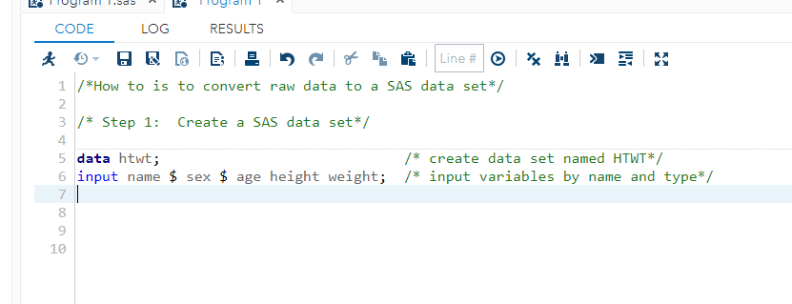
The Beginning: How to is to convert raw data to a SAS data set
Code
You have the following typed in.

Slide 31
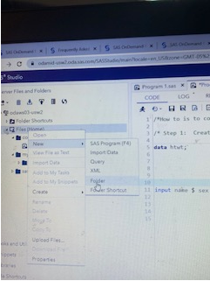
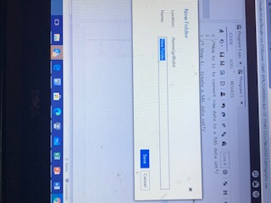
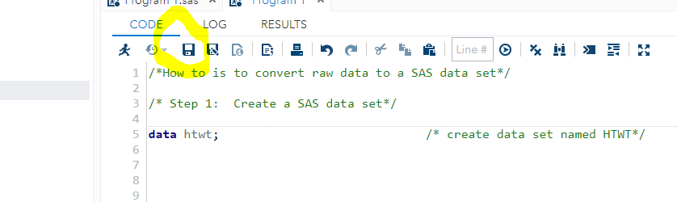
How to save code
Step 3: click save as button and save in folder
Step 1: create folder to save code
Step 2: name folder

Slide 32
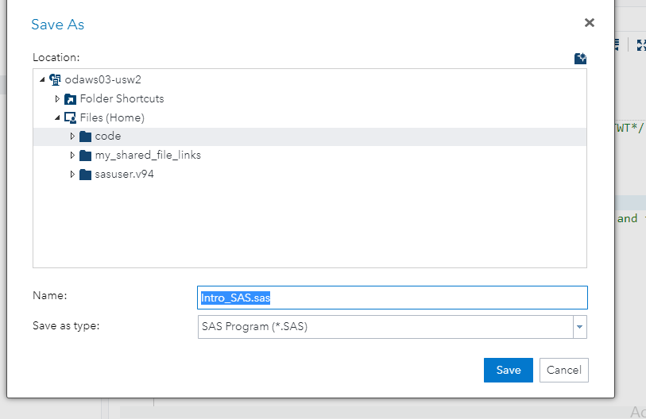
How to save code

Slide 33
How to is to convert raw data to a SAS data set
Subjects | Gender | Age | Height | Weight
Mike | M | 14 | 69 | 112
Tasha | F | 13 | 56 | 84
Maggie | F | 14 | 62 | 102
Sean | M | 15 | 67 | 135
John | M | 16 | 70 | 165
Sophia | F | 16 | 63 | 120
We need to enter the data.

Slide 34
The Beginning: How to is to convert raw data to a SAS data set
* Step 2: Input observations ;
* the cards statement precedes data. The data lines;
* DO NOT have semi-colons ;
*input name $ sex $ age height weight;
cards;
Mike M 14 69 112
Tasha F 13 56 84
Maggie F 14 62 102
Sean M 15 67 135
John M 16 70 165
Sophia F 16 63 120
;
Run;
cards: Tells SAS the following lines are data. Data must follow

Slide 35
End: Run program
*END: Run the program. 1 step;
* Step 4: Run the program;
run; *Run the above statements;

Slide 36
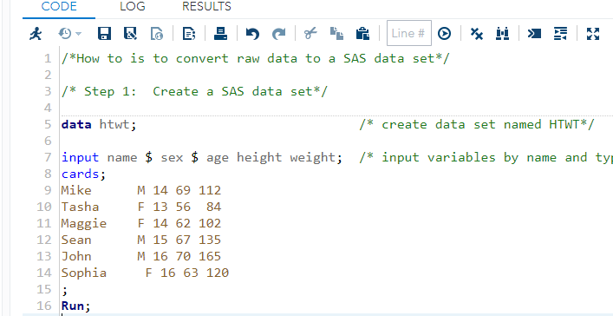
The Beginning: How to is to convert raw data to a SAS data set
Code

Slide 37
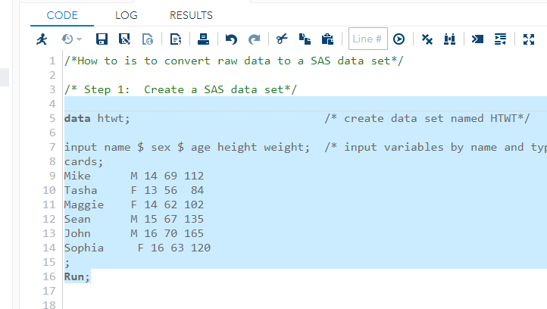
The Beginning: How to is to convert raw data to a SAS data set
To run program: Highlight code you want to run and press running man

Slide 38
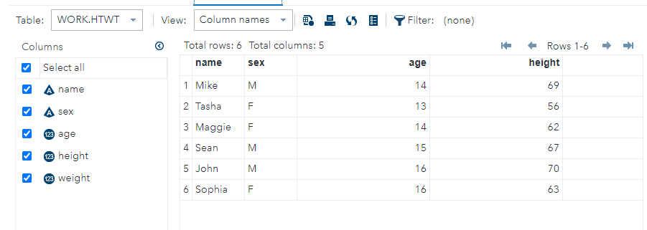
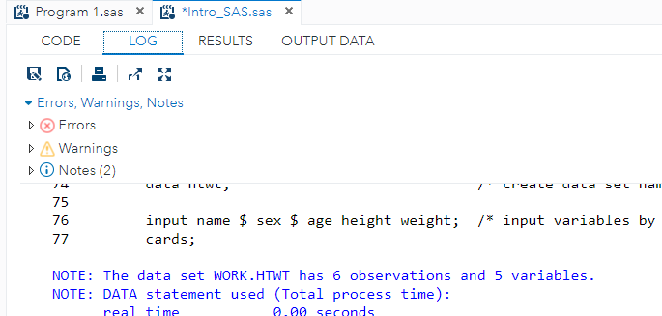
The Beginning: How to is to convert raw data to a SAS data set
Output data and Log stating the number of variables and observations

Slide 39
Middle: Work with data
We will now discuss the following summary procedures:
Print Procedure
Means Procedure
Plot Procedure
Univariate Procedure
Plot Procedure (graphing)
proc:A SAS procedure. These are how you work with thedata in SAS. There are many SAS procedures.

Slide 40
Proc Print
Print Procedure
PROC PRINT is used to print data to the output window
By default, prints all observations and variables in the SAS data set
General Form: PROC PRINT DATA=input_data_set <options>
<optional SAS statements>;
    RUN;
Some Options
  input_data_set (obs=n) - Specifies the number of observations to be printed in the output
  NOOBS - Suppresses printing observation number

Slide 41
Middle: Work with data
Print the data: You Try
/* Work with the data*/
proc print data =htwt; /* print the data*/
title 'Height-Weight Example #1'; /*put title with data*/
Run;
print: SAS procedure to create an output file. By default,
uses the data from the last data statement.

Slide 42
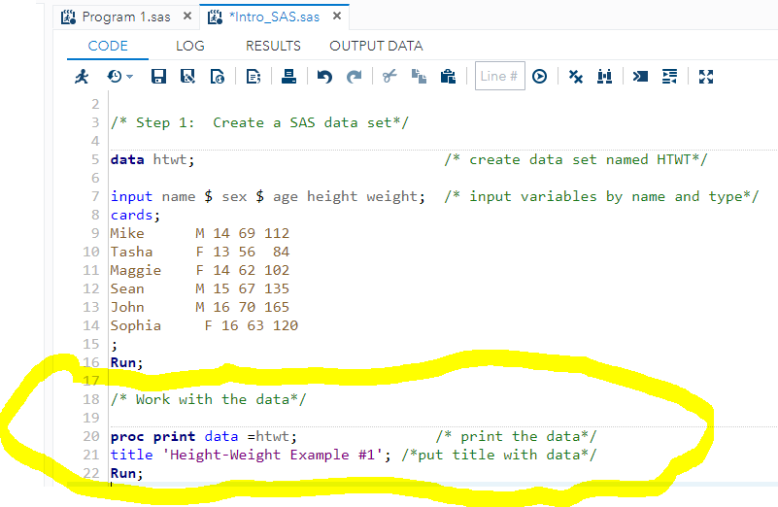
Height-Weight Example
SAS program

Slide 43
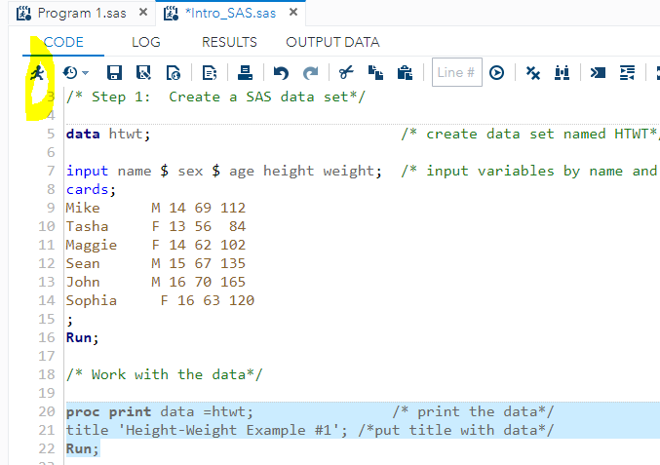
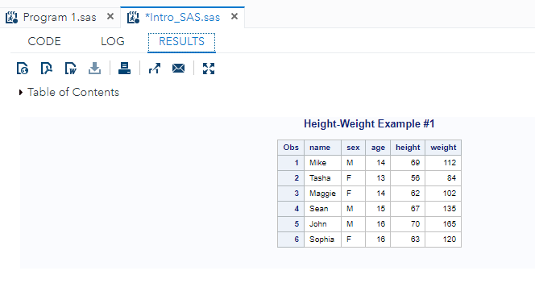
Height-Weight Example
Highlight and run code to print data
Results

Slide 44
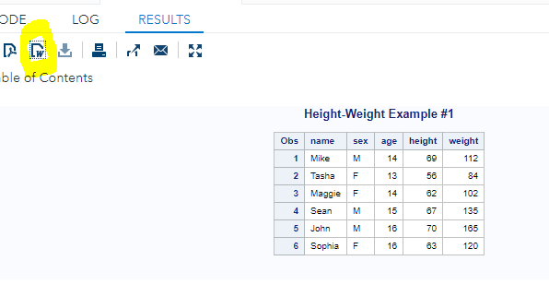
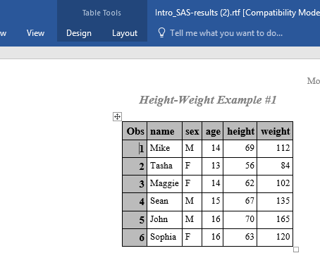
How to output SAS Into Microsoft word
Word output
Click on the Microsoft word symbol. This will output your results into a word file.

Slide 45
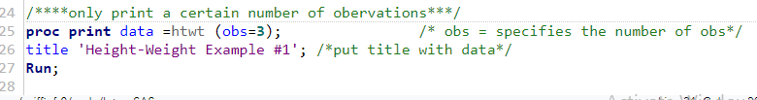
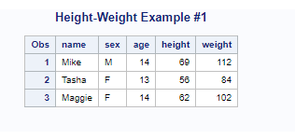
Proc Print
Print Procedure
Some Options
  input_data_set (obs=n) - Specifies the number of observations to be printed in the output
  NOOBS - Suppresses printing observation number
  SAs
  SAS code SAS output:
  SAS Output:

Slide 46

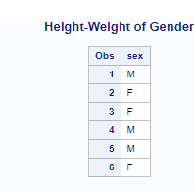
Proc Print
Print Procedure
  VAR variable1 variable2 variable3;
    Prints only listed variables in the output
  SAS code:
  SAS output

Slide 47

Proc Means
Means Procedure
General Form: PROC MEANS DATA= name of dataset;
RUN;
  Means procedure will print out the number of non-missing values, mean, standard deviation, minimum, and maximum for all numeric variables (quantitative variables) in the input data set
  SAS code:

Slide 48
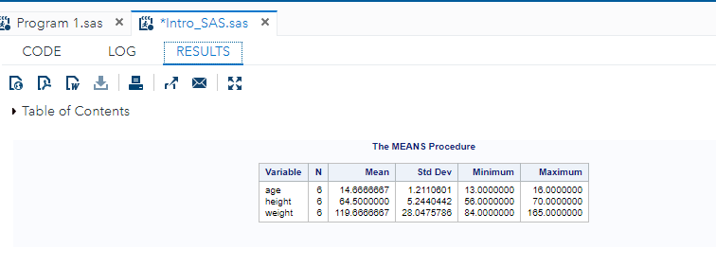
Proc Means
Means Procedure
SAS output Descriptive summaries of all the quantitative variables in the data set

Slide 49

Proc Means
Means and Standard Deviations can be easily calculated for variables in a SAS data set using the means procedure
  List all the variables you want summary statistics for on the second line by using the “var” statement
  You Try: only provide summary statistic for age

Slide 50
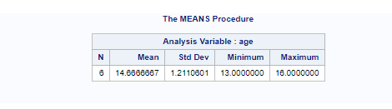
Output from proc means

Slide 51
SAS Data Sets: Temporary Library VS Permanent Library
SAS Data Sets and Data Libraries
SAS Data Libraries
  Contain SAS data sets
  Identified by assigning a library reference name – libref
  Temporary library
    Work library
    SAS data files are deleted when session ends
    Library reference name not necessary
    example htwt or work.htwt
  Permanent library
    SAS data sets are saved after session ends
    SASUSER library
    You can create and access your own libraries
Temporary file. Will delete when SAS is closed

Slide 52
How to create a permanent library
Libname will create a permanent library.
have names with syntax
<libname.>datasetname
libname defaults to work if omitted

Slide 53
How to access data for the course (MAT: 3312)
I have also uploaded data for us to use in our course. You will be able to access that data using a LIBNAME or FILENAME statement with this path:
~/my_shared_file_links/griffinfr0.
Type the following in your SAS program:
LIBNAME datalib "~/my_shared_file_links/griffinfr0/" access=readonly;
How to call any dataset for the call.
Datalib.name of dataset.

Slide 54
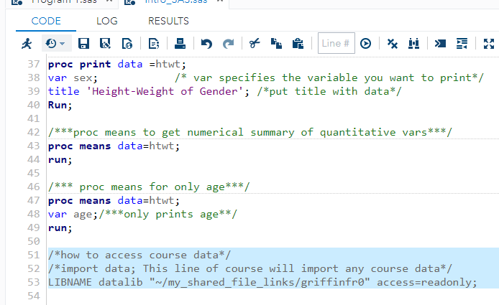
Import DATA: How to access data for the course (MAT: 3312)
Highlight and run code. This will import all course data

Slide 55
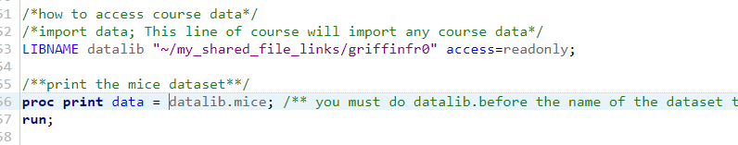
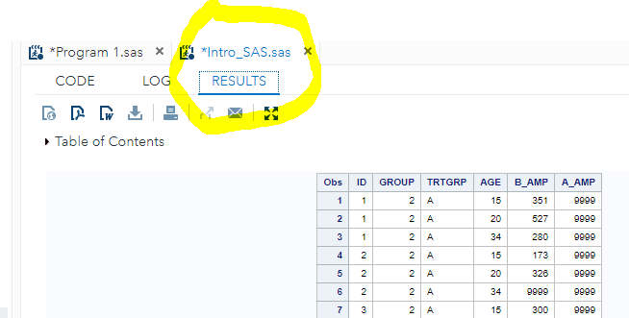
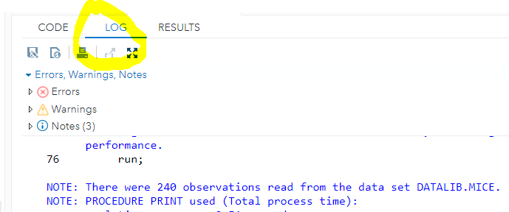
Permanent library

Slide 56

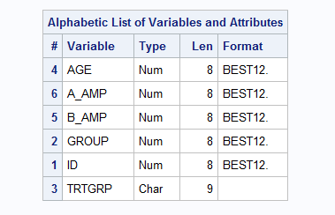
Proc contents
Code:
Output:
Proc contents: The variables' names, types, and attributes (including formats, informats, and labels)
What is you want to know the names of all the variables in the datasets. Use the following lines
Proc contents data = name of dataset;
Run;

Slide 57
TEAM Assignment
Download the Team Assignment 1 from Canvas

Slide 58
Proc Univariate
Univariate Procedure
PROC UNIVARIATE is used to examine the distribution of data
Produces summary statistics for a single variable
  Includes mean, median, mode, standard deviation, skewness, quantiles, etc.
Code: PROC UNIVARIATE DATA=data_set_name;
    VAR variable name1 variable name2;
    RUN ;
If the variable statement is not used, summary statistics will be produced for all numeric variables in the input data set.

Slide 59
How to create a Histogram
Univariate Procedure
        To create a histogram:
Code:
PROC UNIVARIATE DATA=data_set_name;
    VAR variable name;;
    histogram variable name;
    RUN ;

Slide 60
How to create Bar Charts
Plot Procedure
  How to create bar charts:
  Proc Sgplot: is used for graphical analyses. It identifies the data set that contains the plot variables
  Code:
  PROC SGPLOT DATA= name of data set;
  vbar variable name;
  Title “title of graph”;
  RUN;

Slide 61
TEAM Assignment
Download the Team Assignment 1 from Canvas
Break up into groups and complete the team assignment.
  Everyone must upload their own work into canvas
  Please make sure your name and date is on your paper.

Slide 62

MICE Example
Find median, mode, range, Q1, and Q3, of age in the mice dataset?
Code:

Slide 63
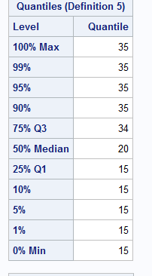
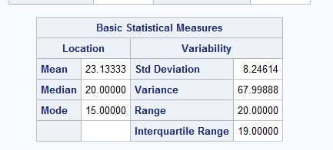
MICE Example
Find median, mode, range, Q1, and Q3, of age in the mice dataset?
output:

Slide 64
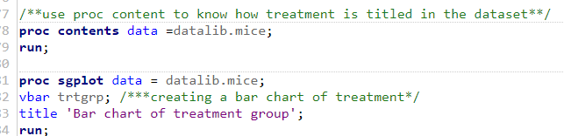
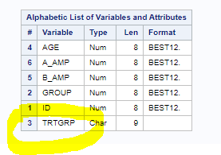
MICE Example
Create a bar Chart of the variable treatment group? Title the bar chart Bar Chart of Treatment First and Last name
Code:

Slide 65
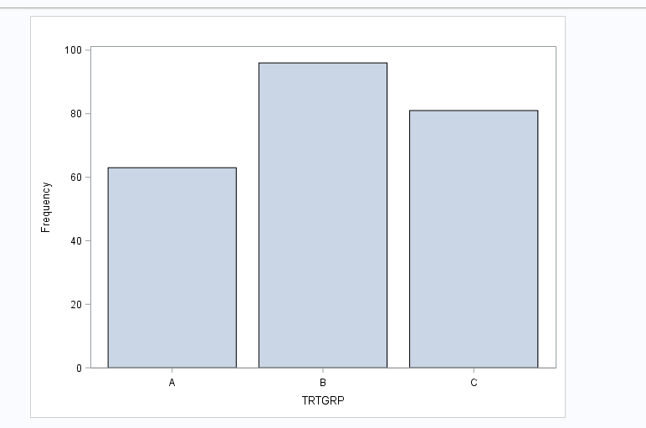
MICE Example
Create a bar Chart of the variable treatment group?
Output:

Slide 66
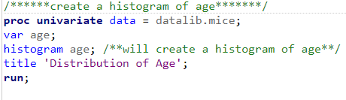
MICE Example
Create a histogram of age ?
Code:

Slide 67
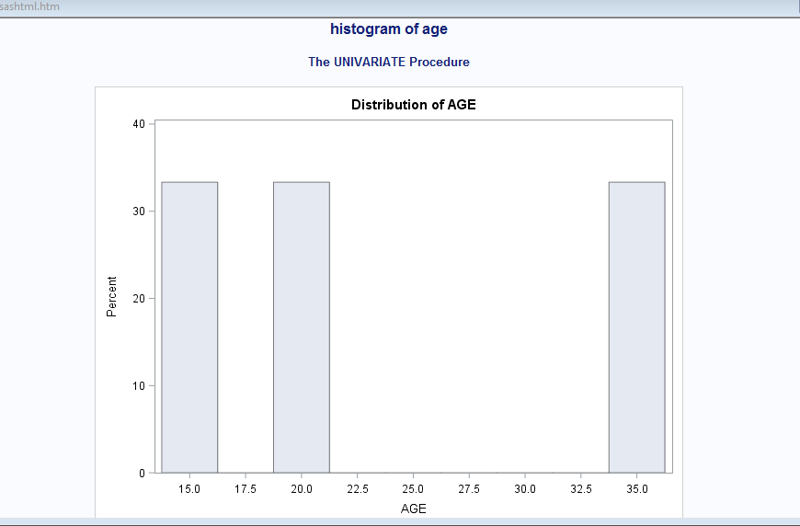
MICE Example
Create a histogram of age ?
OUTPUT:

